Slide 1
Research Internship
Possible areas of research for internship

Slide 2
Introduction
Bachelor of Design
Human Computer Interaction
Interaction Design
Railway Control Panel Redesign Project

Slide 3
HCI
Human Computer Interaction Design of interfaces between people and computer/machine
Visual, physical, emotional and ergonomic aspects

Slide 4
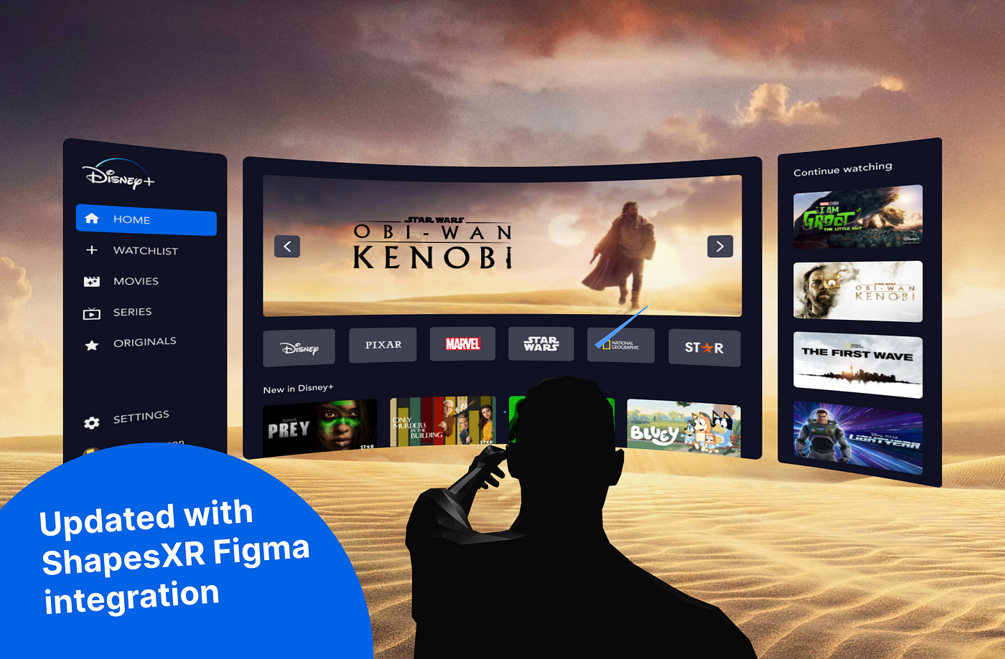
Applications of hci in Avionics
Control panel design using VR lab

Slide 5
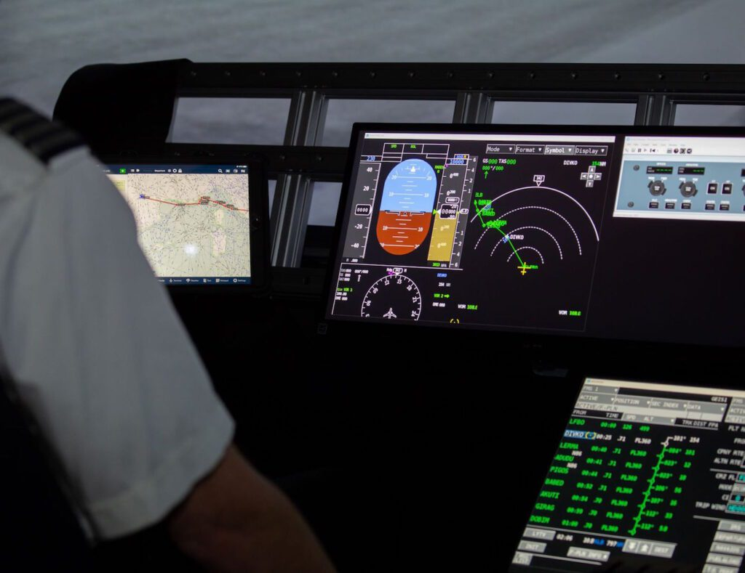
Applications of hci in Avionics
Digital interface redesign- User Experience Design

Slide 6

Applications of hci in Avionics
Research on applications of HCI in emerging avionics technologies

Slide 7
Thank You

